Slide 1

PhD Defense:
Statistical Understanding of Adversarial Robustness
Morgane Goibert
Supervisors: Stéphan Clémençon, Clément Calauzènes, Elvis Dohmatob and Ekhine Irurozki
Institutes: Télécom Paris and Criteo
November, 30th 2023
Notes:
Thanks...
- Members of the jury
- Reporters
- My supervisors
Brief one liner of my subject

Slide 2
Content Overview
Outline and Motivation
Robust Consensus Ranking via Bucket-based Plugin
  Introduction
  Previous works: classical methods to solve the Consensus Ranking task
  Previous works: classical statistical robustness concepts
  Contribution 1: evaluating the robustness of Consensus Ranking statistics
  Contribution 2: bucket-based plugin to robustify Consensus Ranking statistics
Detecting Adversarial Attacks in DNNs by Studying their Topology
  Introduction
  Previous works: adversarial attacks and defense in deep learning
  Previous works: topological data analysis
  Contribution 1: the under-optimized edges hypothesis
  Contribution 2: detecting adversarial examples
Conclusion
Notes:
1) Intro --> contextualize + contributions
2) Detail 2 contributions --> one on each settings

Slide 3
Outline and Motivation

Slide 4






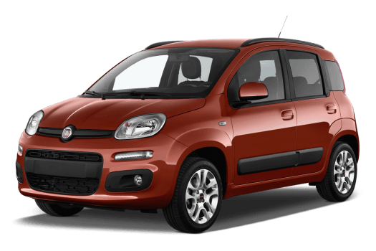




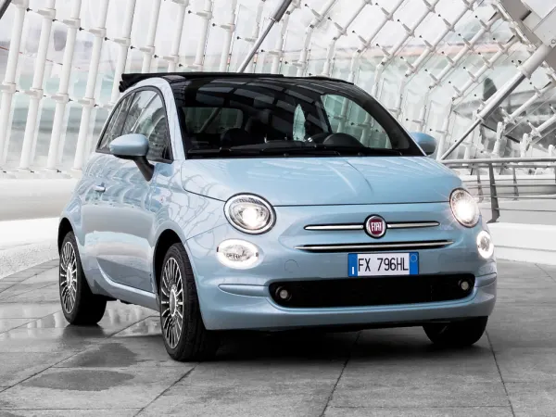
Outline and Motivation
User
Brand
>
>
Notes:
Why robustness important for Criteo?
--> Criteo does advertisement on the internet
--> the engine interact with users and brands
--> pain points
PAUSE

Slide 5
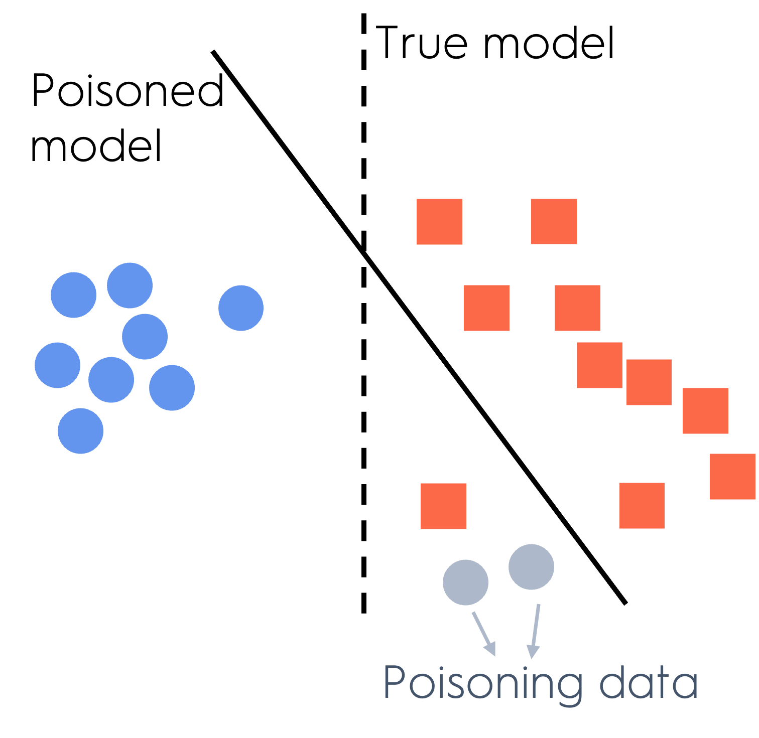
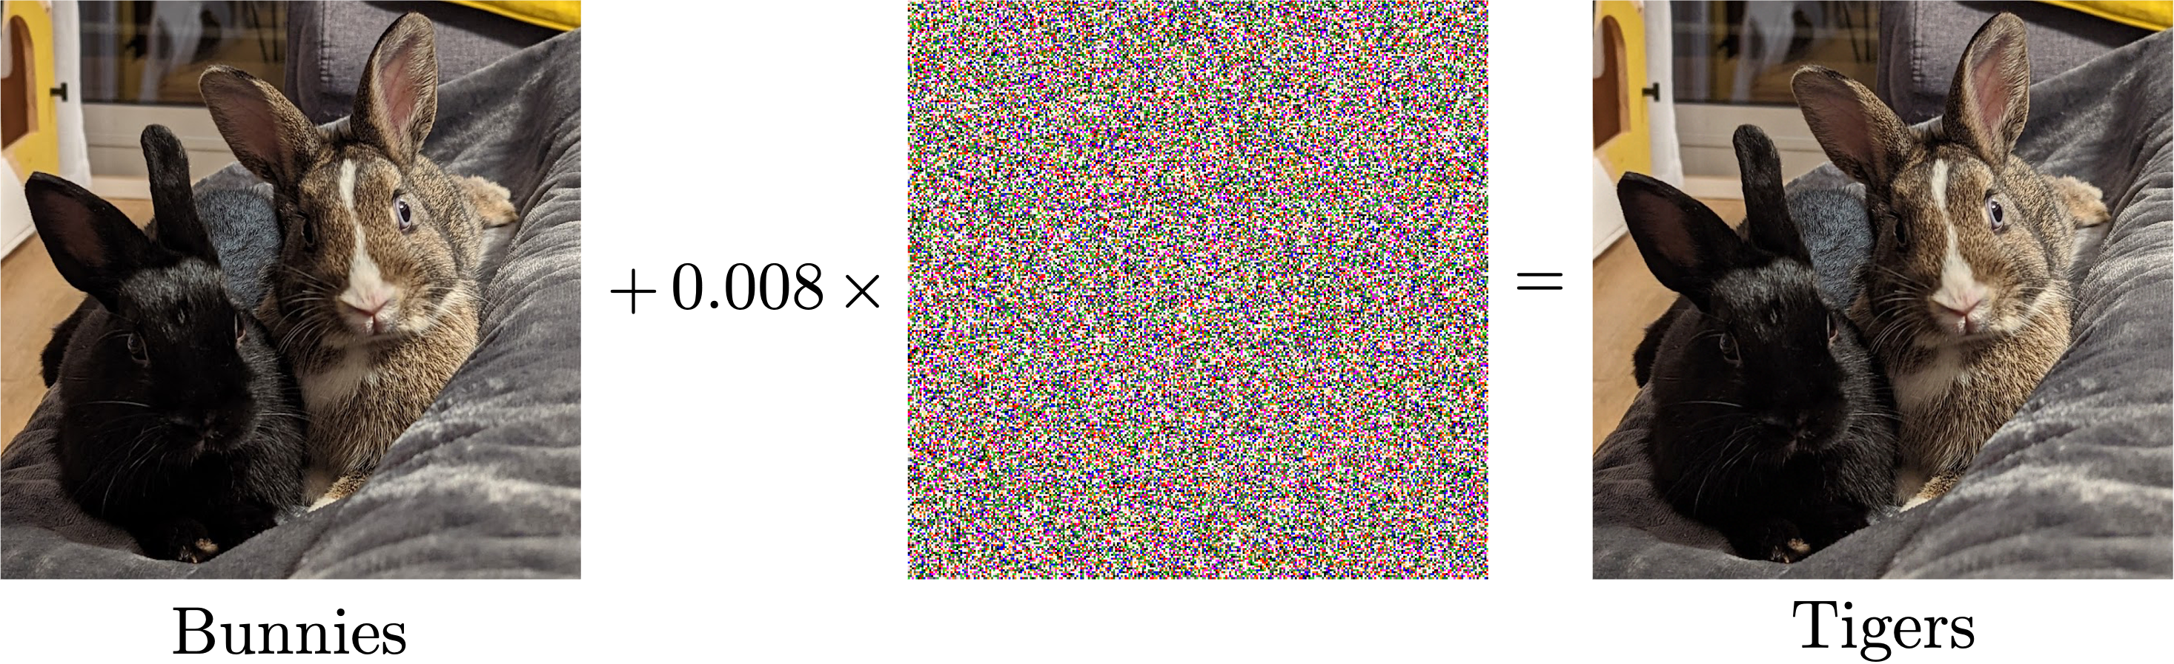
Outline and Motivation
Two types of attacks… [Chakraborty et al. 2018]
Supervised Learning: → the data
→ algorithm (outputs a model)
→ Evaluation metric of model on distrib.
Poisoning attacks operates at training time. It creates an attack distribution
Evasion attacks operate at inference time. It create an attack distribution
Budget constraint
Attack amplitude
Notes:
My goal is to defend against some attacks
First: context --> lightweight notations
Now: deal with attacks

Slide 6
Outline and Motivation
… for two fields of study
Poisoning attacks are new in the field of rankings, which have many applications in Recommender Systems:
  Top-k ranking (eg Google search)
  Learning-to-rank (Movies, product recommendation)
Evasion attacks are currently deeply studied in deep learning, mainly for Image Classification applications:
  Industrial safety applications (airport recognition systems, self-driving cars, etc.)
  Improve NNs performance (link with generalization, etc.)
Notes:
These two types of attacks are relevant in different fields of applications
PAUSE

Slide 7
Outline and Motivation
Overview of main contributions 1/2
Pioneering the study of Robustness for Ranking Data
Body of works that study the Consensus Ranking Task, e.g. [Condorcet 1785], [Kemeny 1959], [Dwork et al. 2001], [Korba et al. 2017]
Very few works on robustness [Agarwal et al. 2020]
Challenges come from the nature of the space: it is not a vector space and it has a combinatorial nature.
Contributions [MG, Clémençon, Irurozki, Mozharovskyi, 2022], [MG, Calauzènes, Irurozki, Clémençon, 2023]
  Introduction of depth functions to get orders on rankings
  Trimming strategy to robustify consensus ranking
  Evaluation of robustness of consensus statistics through breakdown functions (theoretical & algorithmic)
  Bucket-based plugin to robustify consensus statistics
Notes:
Now let's see more precisely the context and the contributions of my works
The first setting: poisoning attacks for ranking data --> more precisely tackle consensus ranking task

Slide 8
Outline and Motivation
Overview of main contributions 2/2
Understanding and Unifying Recent Advances on Adversarial Robustness
Large body of works crafting attacks and defense methods or providing theoretical bounds on the vulnerability of models or providing explanation for the success of adversarial attacks, e.g. [Szegedy et al. 2013], [Goodfellow et al. 2014], [Madry et al. 2018] [Moosavi-Dezfooli et al. 2016 and 2017], [Dohmatob 2019]
Challenges come from the lack of unification and understanding of the phenomenon, as it is very hard to study theoretically.
Contributions [MG, Ricatte, Dohmatob 2022], [MG, Dohmatob, Guo, 2023]
  Topological study of Neural Networks
  The under-optimized edge hypothesis that gather several previously unveiled characteristics of adversarial attacks
  The PGD detection method
  Theoretical analysis of universal/low-dimensional attacks
  Introduction of the adversarial viability of a subspace and geometric analysis
Notes:
In the second setting the context is very different --> many many works since 2013 on adversarial robustness
PAUSE

Slide 9
Robust Consensus Ranking via Bucket-based Plugin
Notes:
Ok so now let's dive into these contributions that I mentioned, starting with this one...

Slide 10
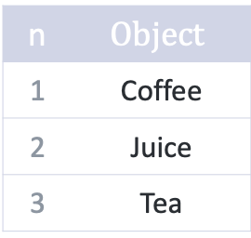
Introduction
Rankings
Problem: being robust to poisoning attacks
→ What are and ?
n | $$Object$$
1 | Coffee
2 | Juice
3 | Tea
Rankings are complete ordering over set of items:
Example: juice is better than tea is better than coffee
Formalization: a ranking is:
  A bijective function from to such that , e.g.
  A strict total order i.e. a sequence s.t.
  e.g.
No feature regime:

Slide 11
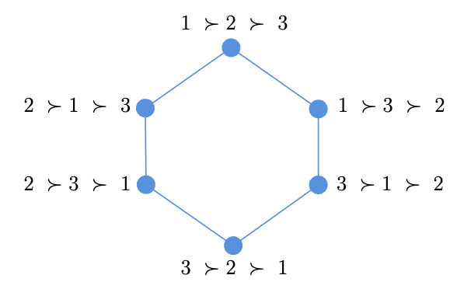
Introduction
Metrics on the space of rankings
Problem: being robust to poisoning attacks
→ How to define ?
is metrizable
Kendall-Tau distance: s.t.
Other distances:
  Spearman’s Footrule (L1 norm): s.t.
  Spearman’s Rho (L2 norm): s.t.

Slide 12
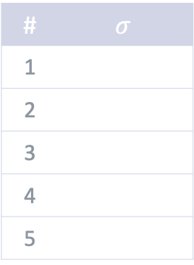
Classical Methods to Solve Consensus Ranking
Consensus Ranking and Kemeny’s Consensus
Problem: being robust to poisoning attacks
→ Which task model is solving?
Goal:
Given a probability distribution over the ranking space the Consensus Ranking task consists in finding the ranking that best summarizes it.
Formalisation for Kemeny’s Consensus
Kemeny’s consensus statistic is a function solving
Its output is denoted by and called Kemeny’s consensus.
# | $$σ$$
1
2
3
4
5
Properties: Kemeny’s consensus satisfies many useful properties (Condorcet Criterion, etc.) but is NP-hard to compute, except when the underlying distribution is Stochastically Transitive
[Dwork et al. 2001]
[Korba et al. 2017]

Slide 13
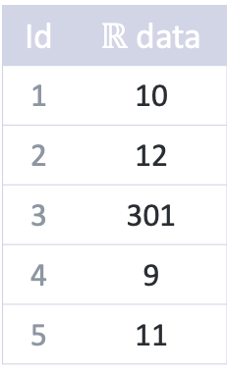
Classical Methods in Statistical Robustness
Robustness Concepts and Principles
Problem: being robust to poisoning attacks
→ On the “defense” side, how do we measure robustness of a statistic ?
Robust Statistics:
Evaluation:
[Huber, 1964]
Statistic:
Breakdown Function: The minimal amount of budget required to fool the statistic for distribution
  Budget: difference between the original distribution and the “attack” distribution measured by (e.g. total-variation, Wasserstein)
  Fool: change the output of the statistics by an amount of at least measured using another distance
Id | $ℝ$ data
1 | 10
2 | 12
3 | 301
4 | 9
5 | 11
Mean = 68.6
Median = 11
Trimmed mean = 10,5

Slide 14
Evaluating the Robustness of Consensus Rankings
Evaluating the Breakdown Functions – Theoretical Bounds 1/2
[MG, Calauzènes, Irurozki, Clémençon, 2023]
Theorem – Upper Bound for Kendall-Tau
Theorem – Lower Bound for all distances
[MG, Calauzènes, Irurozki, Clémençon, 2023]

Slide 15
Evaluating the Robustness of Consensus Rankings
Evaluating the Breakdown Functions – Theoretical Bounds 2/2
Sketch of proof:
The upper-bound proof relies on showing that for , the attack distribution
is a valid attack according to the definition of the breakdown function.
The rest of the proof for the upper-bound and the lower-bound comes from computation leveraging matrix notations.

Slide 16
Evaluating the Robustness of Consensus Rankings
Approximate Evaluation of the Breakdown Functions – Our Practical Algorithm
Recall the def:
Lagrangian simplified version:
Smoothing:
with
Optimization: Stochastic saddle-point problem → We run Monte-Carlo estimation for and stochastic gradient
descent/ascent
Piecewise constant
Gaussian
kernel

Slide 17
Evaluating the Robustness of Consensus Rankings
Our Bucket-Based Plugin to Robustify Consensus Statistics 1/3
Buckets:
Idea: allow for indifference between items
Example: juice is the same as tea is better than coffee
Formalization as strict weak orders:
is a sequence of disjoint subsets:
As sets of rankings:
As distributions:
Distance:
As a bucket ranking is a set, we can use a classical Hausdorff extension of metrics to sets.

Slide 18

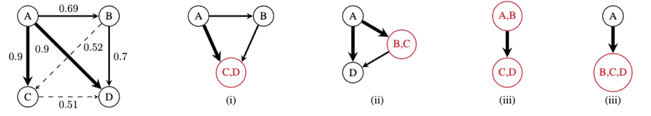
Evaluating the Robustness of Consensus Rankings
Our Bucket-Based Plugin to Robustify Consensus Statistics 2/3
Robustifying Kemeny’s Consensus
Idea: if two items are very close to each other, merge them into the same bucket
  Close: use the pairwise values
Example: 51% of people say
  49% of people say
Challenge: hard to know how to merge in general
very close to 0.5 → merge 2 & 3 in the same bucket

Slide 19
Evaluating the Robustness of Consensus Rankings
Our Bucket-Based Plugin to Robustify Consensus Statistics 3/3
big
small
How it works:
Input: pairwise matrix , Kemeny’s consensus and threshold
Idea: 0) Init
1) find the pair of items st (the deviation is ok)
                is maximal (select the “worst pair” aaaaa amongst the possible ones)
  2) merge and all items in between (update )
  3) update by taking the max (no transitivity)
Repeat until 1) is empty
Evaluation goal:
Get a more robust consensus, obviously
Do we loose in precision? Does get too high?
[MG, Calauzènes, Irurozki, Clémençon, 2023]

Slide 20
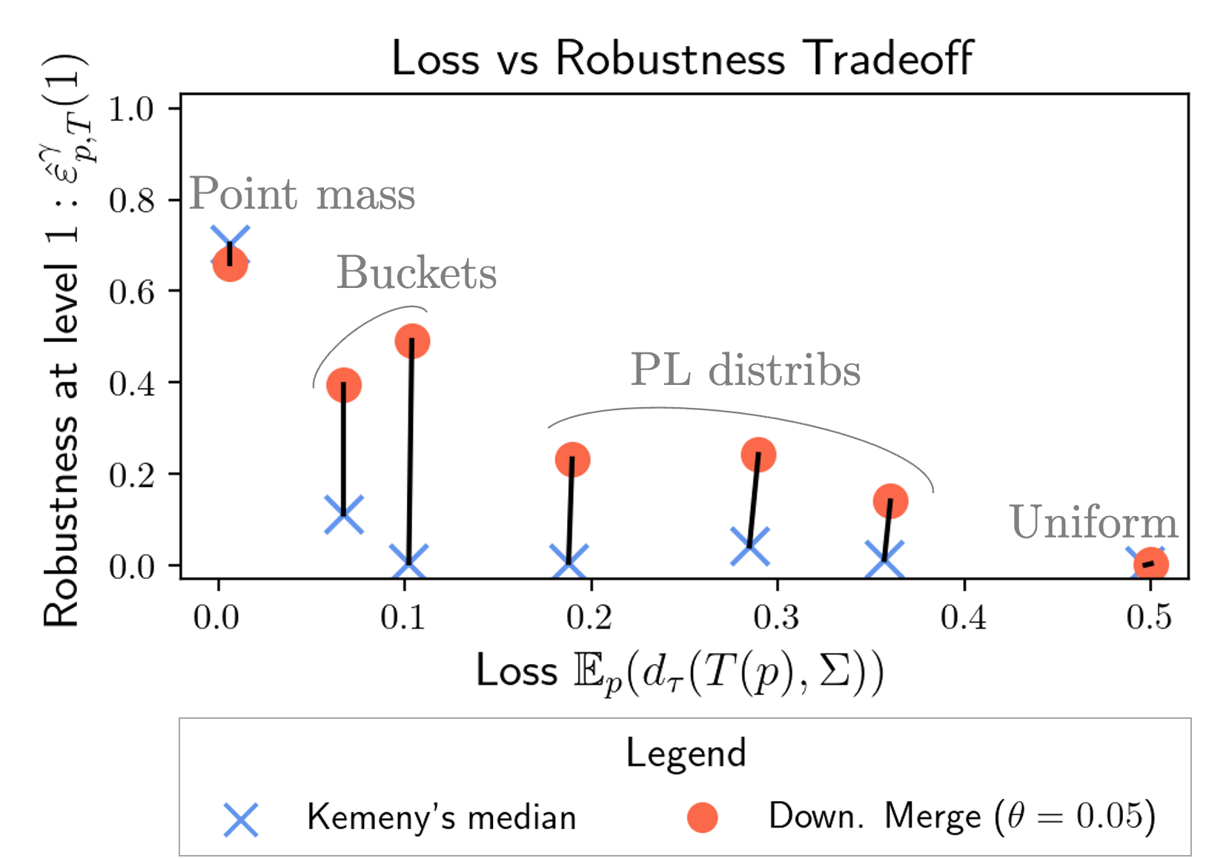
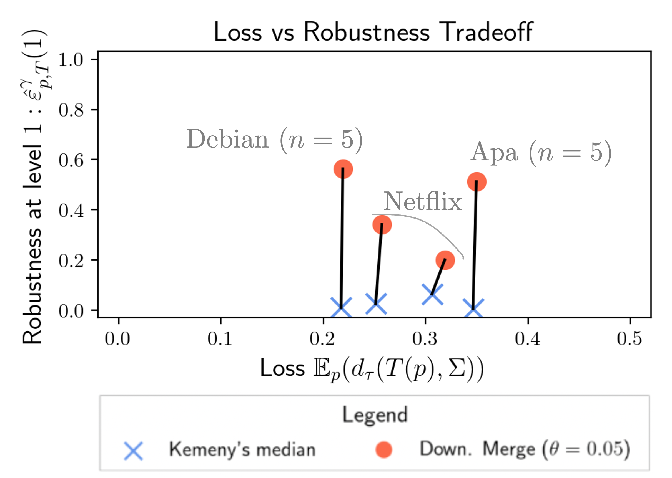
Bucket-Based Plugin to Robustify Consensus Statistics
Experiments
Message: our bucket-based plugin is a much better compromise than classical Kemeny’s consensus!

Slide 21
Robust Consensus Ranking via Bucket-based Plugin
Conclusion
Takeaways:
Practical evaluation of the robustness of any statistics (+ theoretical bounds)
Computationally efficient plugin → complexity in or
Limitation:
Breakdown function evaluation still computationally expensive
Open questions:
Overcome limitation!
Application to practical setups (top-k ranking, etc.)

Slide 22
Detecting Adversarial Attacks in DNNs by Studying their Topology

Slide 23
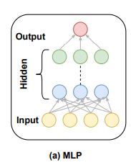
Introduction
Neural Networks
Problem: being robust to evasion attacks
→ What are and ?
Definition: is a MLP on a K classes problem with layers iif:
Evaluation: the accuracy of a neural network on distribution is
Training: the objective is to find the optimal parameters, which is achieve through SGD on the following optim. problem
→
feature map
Activation function (ReLU)
0-1 loss
Consistent surrogate loss (CE)

Slide 24
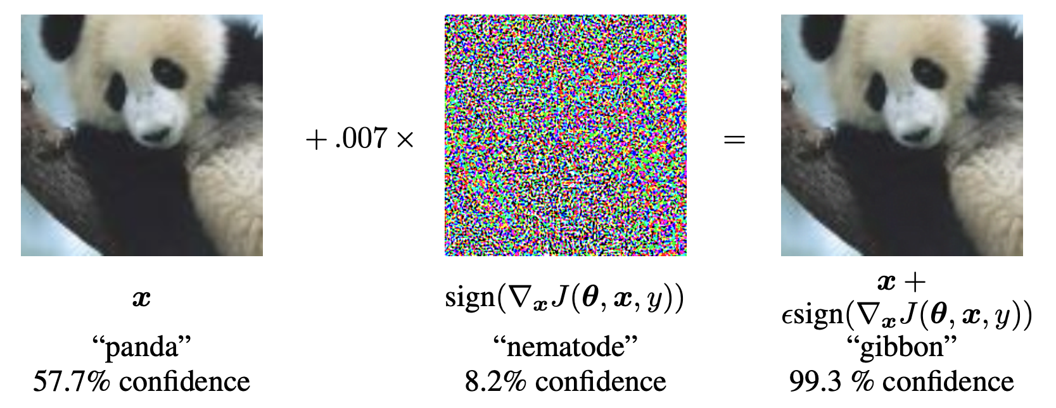
Introduction
Adversarial Attack
Problem: being robust to evasion attacks
→ How to find a relevant ?
Definition of a perfect attack:
with
alternatively:
Practical attacks:
FGSM attack:
[Goodfellow et al. 2014]

Slide 25
The Under-Optimized Edges Hypothesis
Characteristics of adversarial attacks
Architectural properties: linear hypothesis [Goodfellow et al. 2014], study of skip layers, width and depth [Guo et al. 2020], over-parametrization [Wang et al. 2018, 2020]
Training procedure: adversarial training [Goodfellow et al. 2014], loss function [Nar et al. 2019], calibration [Meunier et al. 2022], decision boundary [Fawzi et al. 2018], [Moosavi-Dezfooli et al. 2019]
Behavior of information flow: critical neurons or layers [Aigrain et al. 2019], paths [Cantareira et al. 2021]
Manifold of the data: Off and on-manifold adversaries [Stutz et al. 2019], [Ilyas et al. 2019]
Features extracted from the data: robust/non-robust features [Ilyas et al. 2019], feature space [Agarwal et al. 2019]
Common elements in these characteristics

Slide 26
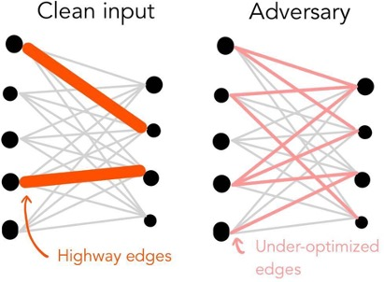
The Under-Optimized Edges Hypothesis
Unifying hypothesis to explains the success of adversarial examples
Concatenate some characteristics into the following source hypothesis → Explain the adv. phenomenon to robustify by detecting
Clean and adversarial inputs induce differences in the topological structure in their respective induced graphs, because under-optimized edges are used by adversaries, but not by clean inputs. Such edges are thus a source of adversarial vulnerability.

Slide 27
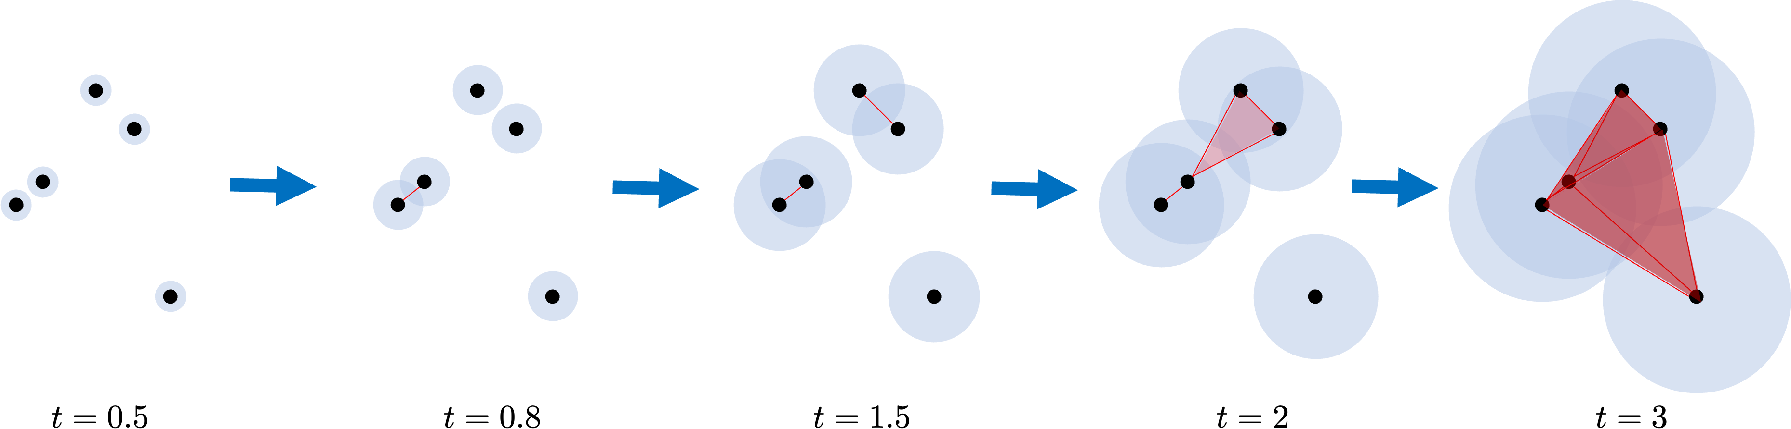
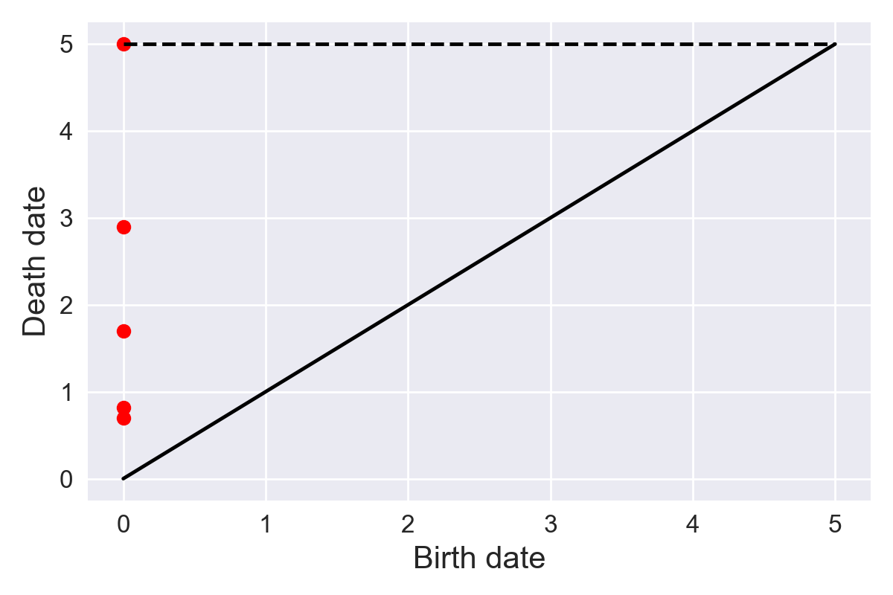
Topological Data Analysis in a Nutshell
From point cloud to persistent diagram
Goal: extracting topological information from high-dimensional point clouds
How:
Complex version: homology groups can be computed from simplicial complexes. Based on a filtration, a graph can be converted to a sequence of simplicial complexes → sequence of homology groups → you can track when each homology group is born and dies
Simple version: a graph can be converted to a sequence of subgraphs based on a filtration → track when a connected component is born and dies
Building a sequence of simplicial complexes via a filtration Persistent diagram

Slide 28
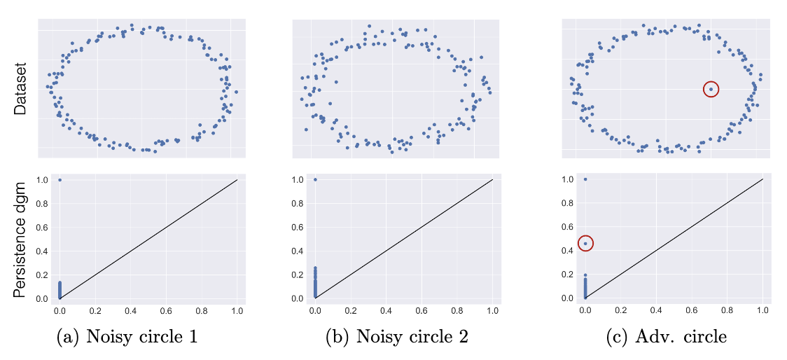
Topological Data Analysis in a Nutshell
Properties of persistent diagrams
Persistent diagrams are robust to random noise… but not to qualitatively different noises such as those induced by adversarial examples

Slide 29
Extracting the Topological Features
Building the Thresholded Induced Graph
Goal: Now we have our hypothesis & our tools → we build our features for our detector
Defintion for a MLP: for a feature map with parameters and an input , the induced graph is:
Selecting under-optimized edges:
computational efficiency & hypothesis
Magnitude Increase criteria:
Denoted by
[Frankle and Carbin 2019], [Zhou et al. 2019]

Slide 30
Extracting the Topological Features
Persistent Diagram
Filtration definition: an edge between appears at time → strong edges appear first
Persistent Diagram (PD) computation:
Simpler comparative setting:
Raw Graph represents just the weights of the edges
with
Two methods: main one = PD + simple comparator = RG

Slide 31
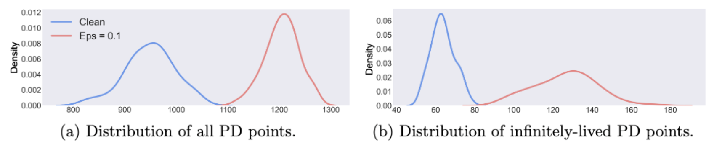
Differentiating Clean and Adversarial Inputs
Differences in simple setups
Framework: Creating the PDs for a bunch of clean inputs and adversarial inputs
Simple case: just counting the number of points / number of infinity-lived points in the persistent diagrams
Dataset MNIST
Architecture LeNet
We can perfectly separate clean and adversarial examples!

Slide 32
Differentiating Clean and Adversarial Inputs
Detection method in complex setups
Pipeline
Pre-processing: run adversarial attacks and keep successful adversarial inputs & take clean inputs
Feature extraction: PD (and RG) & state-of-the-art baselines (LID and Mahalanobis)
Detector: train a one-class SVM (unsupervised) on the clean features for each method
Evaluation metric: AUC + Kernel
PD: Sliced-Wasserstein kernel defined by
Others: RBF kernel defined by
[Ma et al. 2018], [Lee et al. 2018]
[Carriere et al. 2017]

Slide 33
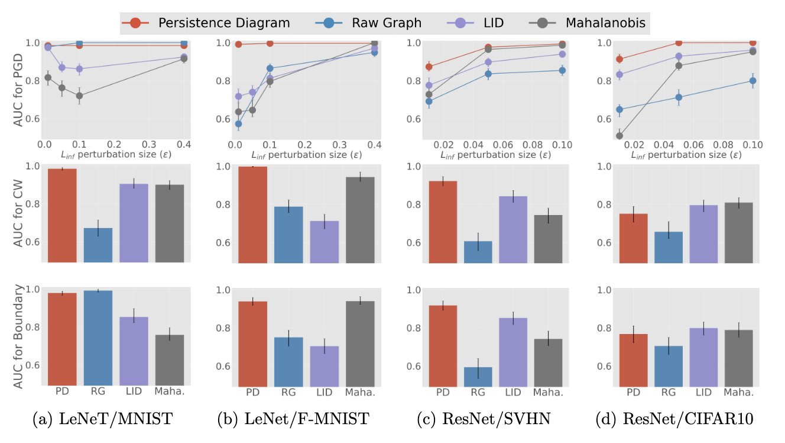
Differentiating Clean and Adversarial Inputs
Results
Persistent Diagram is the most effective detector

Slide 34
Adversarial Robustness and Topology of Neural Networks
Conclusion
Takeaways:
Verified hypothesis on the reasons for the vulnerability of networks
Paved the way for more studies on the topology of networks
Effective detector to identify adversarial inputs
Limitation:
Scaling to very large networks
Parameters and under-optimized edges selection
Open questions:
More theoretical works on the link between robustness and pruning
Identify critical parts of large networks for robustness

Slide 35
General Conclusion
Conclusion
Broad question: how can we make sure that statistical / ML models will remain performant when dealing with corrupted data?
Takeaways
Initialization of the field of robustness for rankings
  I provided:
  Evaluation methods to assess the robustness
  Robust statistics (plugin method, trimming strategy)
Better understanding of the way adversarial attacks work against NNs
  I provided
  1) An hypothesis to explain the success of adversarial examples based on the topology and over-parametrization of NNs
  2) A very efficient detector of adversarial examples
  3) A theoretical analysis of the success of a subclass of adversarial attacks
Broader questions:
Rankings: more/different methods and strategies, systematic analysis, extension to “real-world” tasks
NNs: extension of theory to our practical NNs settings, scaling, link with other topics (generalization, explainability, etc.)

Slide 36
Thank you!

Slide 37
Bibliography
Condorcet, N. (1785). Essai sur l’application de l’analyse à la probabilité des décisions rendues à la pluralité des voix. L’Imprimerie Royale, Paris.
Korba, A., Clémençon, S., and Sibony, E. A learning theory of ranking aggregation. (AISTATS 2017)
Dwork, C., Kumar, R., Naor, M., and Sivakumar, D. Rank aggregation methods for the web. (In Rank aggregation methods for the Web 2021)
Agarwal, A., Agarwal, S., Khanna, S., and Patil, P. Rank aggregation from pairwise comparisons in the presence of adversarial corruptions. (ICML 2023)
Huber, P. J. Robust estimation of a location parameter. (The Annals of Mathematical Statistics 1964)
Szegedy, C., Zaremba, W., Sutskever, I., Bruna, J., Erhan, D., Goodfellow, I., and Fergus, R. Intriguing properties of neural networks (2013)
Goodfellow, I. J., Shlens, J., and Szegedy, C. Explaining and harnessing adversarial examples. (ICLR 2015)
Madry, A., Makelov, A., Schmidt, L., Tsipras, D., and Vladu, A. Towards deep learning models resistant to adversarial attacks. (ICLR 2018)
Lee, K., Lee, K., Lee, H., and Shin, J. A simple unified framework for detecting out-of-distribution samples and adversarial attacks. (NeurIPS 2018)
Moosavi-Dezfooli, S., Fawzi, A., Fawzi, O., and Frossard, P. Universal adversarial perturbations (CVPR 2017)
Moosavi-Dezfooli, S.-M., Fawzi, A., Uesato, J., and Frossard, P. Robustness via curvature regularization, and vice versa. (CVPR 2019)
Wang, L., Ding, G. W., Huang, R., Cao, Y., and Lui, Y. C. Adversarial robustness of pruned neural networks. (2018)
Wang, S., Liao, N., Xiang, L., Ye, N., and Zhang, Q. Achieving adversarial robustness via sparsity (2020)
Meunier, L., Ettedgui, R., Pinot, R., Chevaleyre, Y., and Atif, J. Towards consistency in adversarial classification. (NeurIPS 2022)

Slide 38
Bibliography
Guo, M., Yang, Y., Xu, R., Liu, Z., and Lin, D. When nas meets robustness: In search of robust architectures against adversarial attacks. (CVPR 2020)
Nar, K., Ocal, O., Sastry, S. S., and Ramchandran, K. Cross-entropy loss and low-rank features have responsibility for adversarial examples (2019)
Fawzi, A., Moosavi-Dezfooli, S.-M., Frossard, P., and Soatto, S. Empirical study of the topology and geometry of deep networks. (CVPR 2018)
Aigrain, J. and Detyniecki, M. Detecting adversarial examples and other misclassifications in neural networks by introspection. (ICML 2019)
Cantareira, G. D., Mello, R. F., and Paulovich, F. V. Explainable adversarial attacks in deep neural networks using activation profiles. (2021)
Agarwal, C., Nguyen, A., and Schonfeld, D. Improving robustness to adversarial examples by encouraging discriminative features. (ICIP 2019)
Ilyas, A., Santurkar, S., Tsipras, D., Engstrom, L., Tran, B., and Madry, A. Adversarial examples are not bugs, they are features. (NeurIPS 2019)
Ma, X., Li, B., Wang, Y., Erfani, S. M., Wijewickrema, S., Schoenebeck, G., Song, D., Houle, M. E., and Bailey, J. Characterizing adversarial subspaces using local intrinsic dimensionality. (ICLR 2018)
Dohmatob, E. Generalized no free lunch theorem for adversarial robustness. (ICML 2019)
Carriere, M., Cuturi, M., and Oudot, S. Sliced wasserstein kernel for persistence diagrams. (ICML 2017)
Stutz, D., Hein, M., and Schiele, B. Disentangling adversarial robustness and generalization. (CVPR 2019)
Frankle, J. and Carbin, M. The lottery ticket hypothesis: Finding sparse, trainable neural networks. (ICLR 2019)
Zhou, H., Lan, J., Liu, R., and Yosinski, J. Deconstructing lottery tickets: Zeros, signs, and the supermask. (NeurIPS 2019)

Slide 39
Relevant Publications
Morgane Goibert, Stéphan Clémençon, Ekhine Irurozki, Pavlo Mozharovskyi. A Statistical Depth Functions for Ranking Distributions: Definitions, Statistical Learning and Applications. (AISTATS 2022)
Morgane Goibert, Clément Calauzènes, Ekhine Irurozki, Stéphan Clémençon. Robust Consensus in Ranking Data Analysis: Definitions, Properties and Computational Issues. (ICML 2023)
Morgane Goibert, Thomas Ricatte, and Elvis Dohmatob. An Adversarial Robustness Perspective on the Topology of Neural Networks. (ML Safety Workshop NeurIPS 2022)
Elvis Dohmatob, Chuan Guo, and Morgane Goibert. Origins of Low-dimensional Adversarial Perturbations. (AISTATS 2023)

Slide 40
Additional Slides

Slide 41
Detecting Adversarial Attacks in DNNs by Studying their Topology

Slide 42
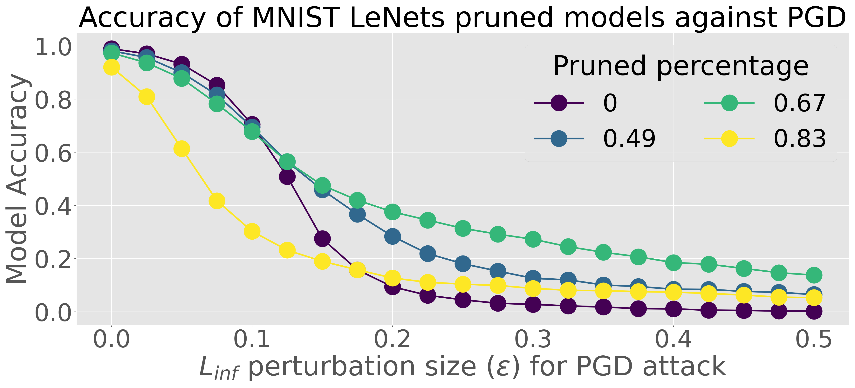
Detecting Adversarial Attacks in DNNs by Studying their Topology
Over-parametrization and Robustness – Theoretical Argument
Let be the set of all weighted paths in :
Active paths:
Weights product:
[MG, Ricatte and Dohmatob 2022]
Interpretation: is an indicator of robustness
→ smaller is better
To get it smaller: have less active paths → pruning of under-optimized edges
Proposition

Slide 43
Depth Functions for Rankings

Slide 44
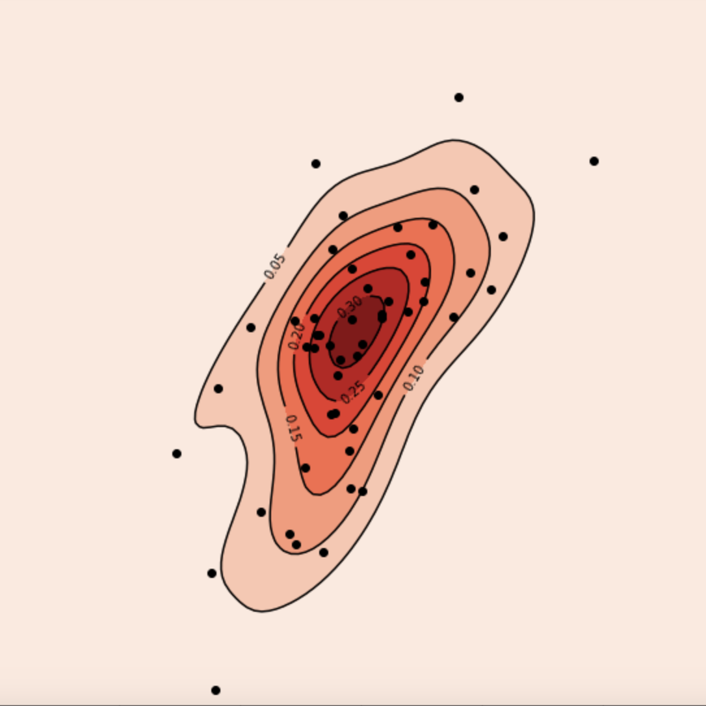
Depth Functions
Definition of Depth Function in
Intuition:
We want a function that gives each point a center-outward ordering by giving , i.e. a score
Axiomatic Definition:
- Affine invariance: The depth scores do not change when we translate all the distribution.
- Maximality at center: If the distribution has a center, the depth scores is maximal at that point. Challenge: Define a center on rankings.
M-center:
simple but too restrictive
H-center:
- Monotonicity: The depth score decreases when we move farther away from the center
ⅹ
center

Slide 45
Depth Functions
Candidate Depth
Our candidate depth function
→ Opposite of the loss
Does it satisfy the axioms?
Yes, but… depends on the distribution → it must be smooth enough
Stochastic Transitivity: if juice is better than tea, and tea is better than coffee, then juice must be better than coffee
→ No cycle
→ Must hold for all groups of 3 items. Not as restrictive as it could seems.
Maths:
For ST distributions our Kendall-tau based depth satisfy all the previous axioms

Slide 46
Depth Functions
Depth Related Statistics
Statistics based on depth
Depth regions and contours:
Depth survivor function:
Quantile regions:
Statistical Learning: we can bound the difference between the theoretical statistics and their empirical counterparts → Takeaway: we can use the depth function in practice
Depth function:
Survivor function:
Quantile regions: similar results

Slide 47
Depth Functions
Trimming: Using the depth to robustify the consensus
Robustness result (theoretical):
The breakdown point for the depth-trimmed Borda statistics is higher than for the classical Borda statistics
  Borda and Kemeny’s consensus can be linked (for specific distributions, they are the same)
  Borda
  Depth-trimmed Borda:
Practical idea – trimming algorithm:
Recursively removing the least deep data point of our dataset. After trimming, compute Kemeny’s consensus
  Benefit 1: improve the robustness (as shown with our theorical argument)
  Benefit 2: extend results to non-ST distributions because after trimming sufficiently, every distributions will eventually be ST.

Slide 48
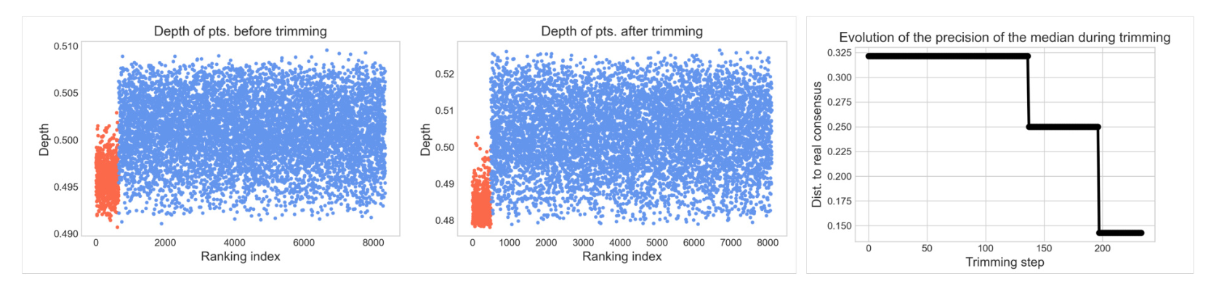

Depth Functions
Experiment – Trimming algorithms
Explanation:
Blue points: original dataset
Red points: adversarial (bad) rankings
Thanks to depth trimming:
The distribution is now ST
We have removed many adversarial rankings
The recovered consensus is much more correct

Slide 49
Depth Functions
Conclusion about depth
Takeaways:
Depth provide a simple way to compute how central or not a ranking is for a distribution / dataset
Trimming strategy based on depth → improved robustness for all sorts of distributions (non-ST)
Depth can be used for various other tasks (graphical methods, homogeneity testing, etc.)
Limitation:
Computationally quite expensive →
nb of iterations Kemeny’s consensus complexity, here
  Idea: transport the depth from the ranking to the score space, perform SGD, and recover the corresponding ranking
2) Practical evaluation of the robustness gain, i.e what is the value of the breakdown function?

Slide 50
Existence of Low-Dimensional Adversarial Attacks

Slide 51
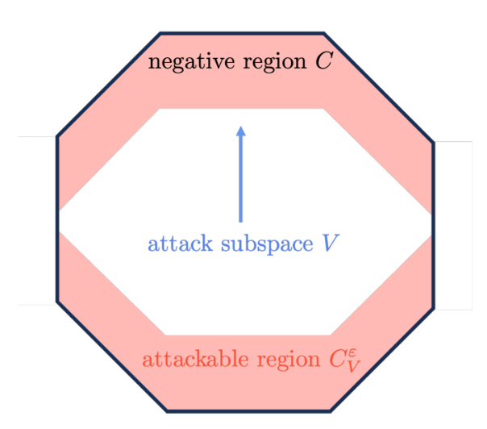
Low dimensional Attacks
Setting
Task:
Binary classification:
e.g
2) Negative decision region:
3) Margin:
Low-dimensional attack:
Attackable region:
Fooling rate of a subspace:
Goal:
Bounds of the type:

Slide 52
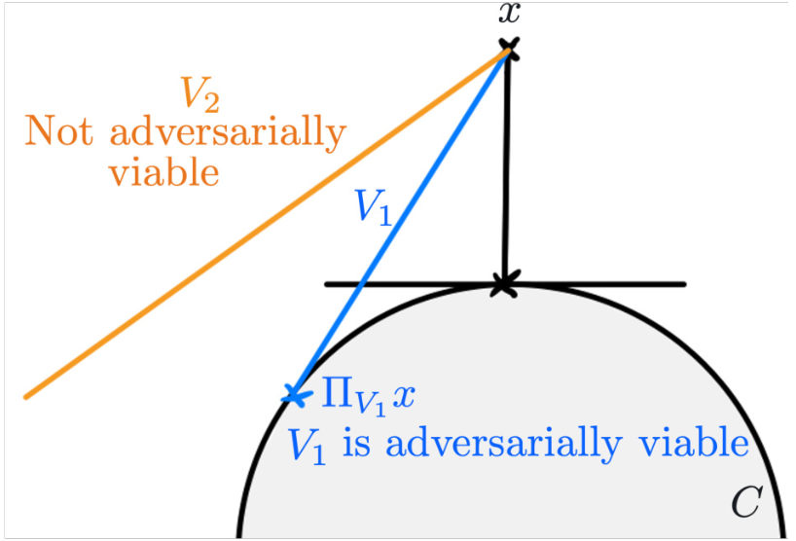
Low dimensional Attacks
Adversarially Viable Subspace
Idea: adversarially viable subspaces allow the attacker to follow the gradient direction within to reach the decision boundary of for most points , hence achieving a high fooling rate.
Definition:

Slide 53
Low dimensional Attacks
Examples of Adversarially Viable Subspace
Random Subspace
Eigen-Subspace

Slide 54
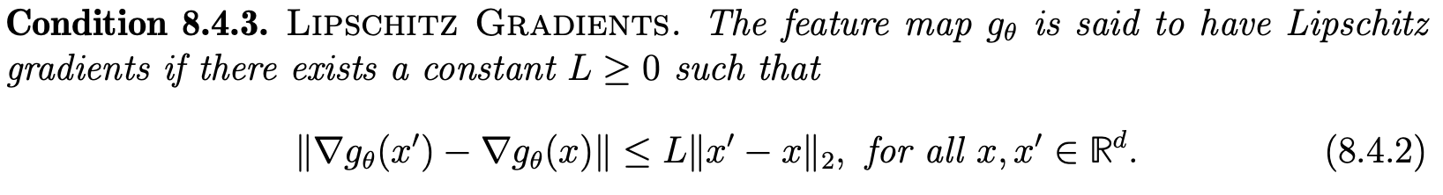
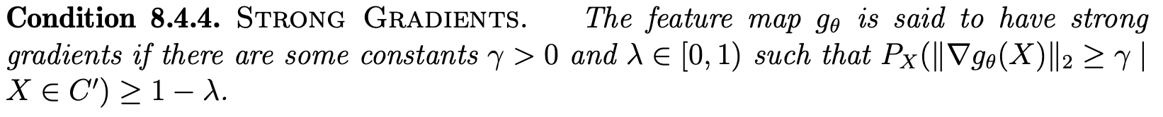
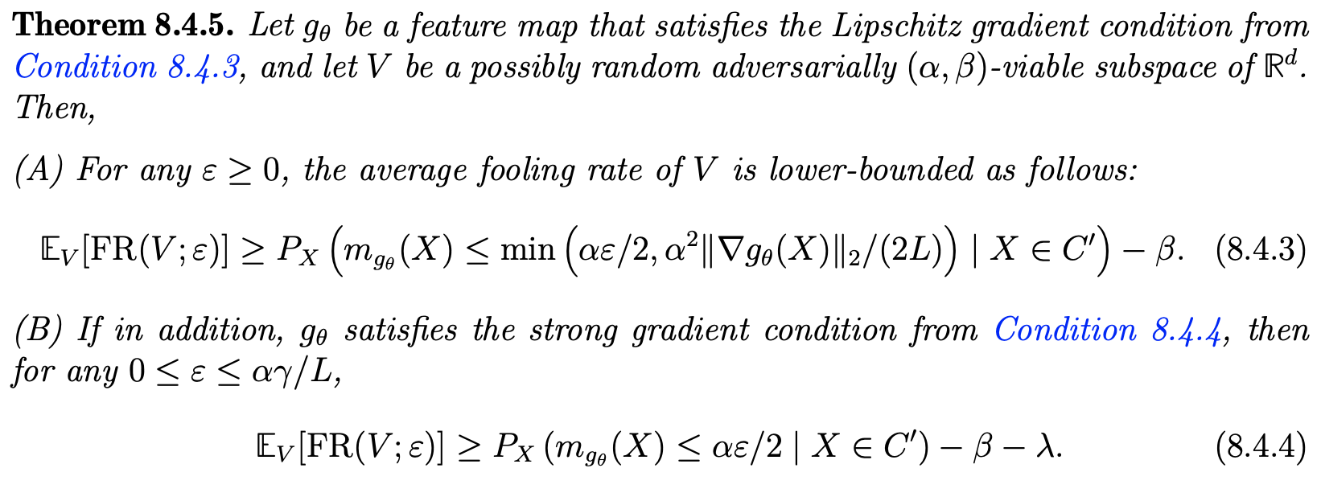
Low dimensional Attacks
Results on models with Lipschitz Decision Boundaries

Slide 55
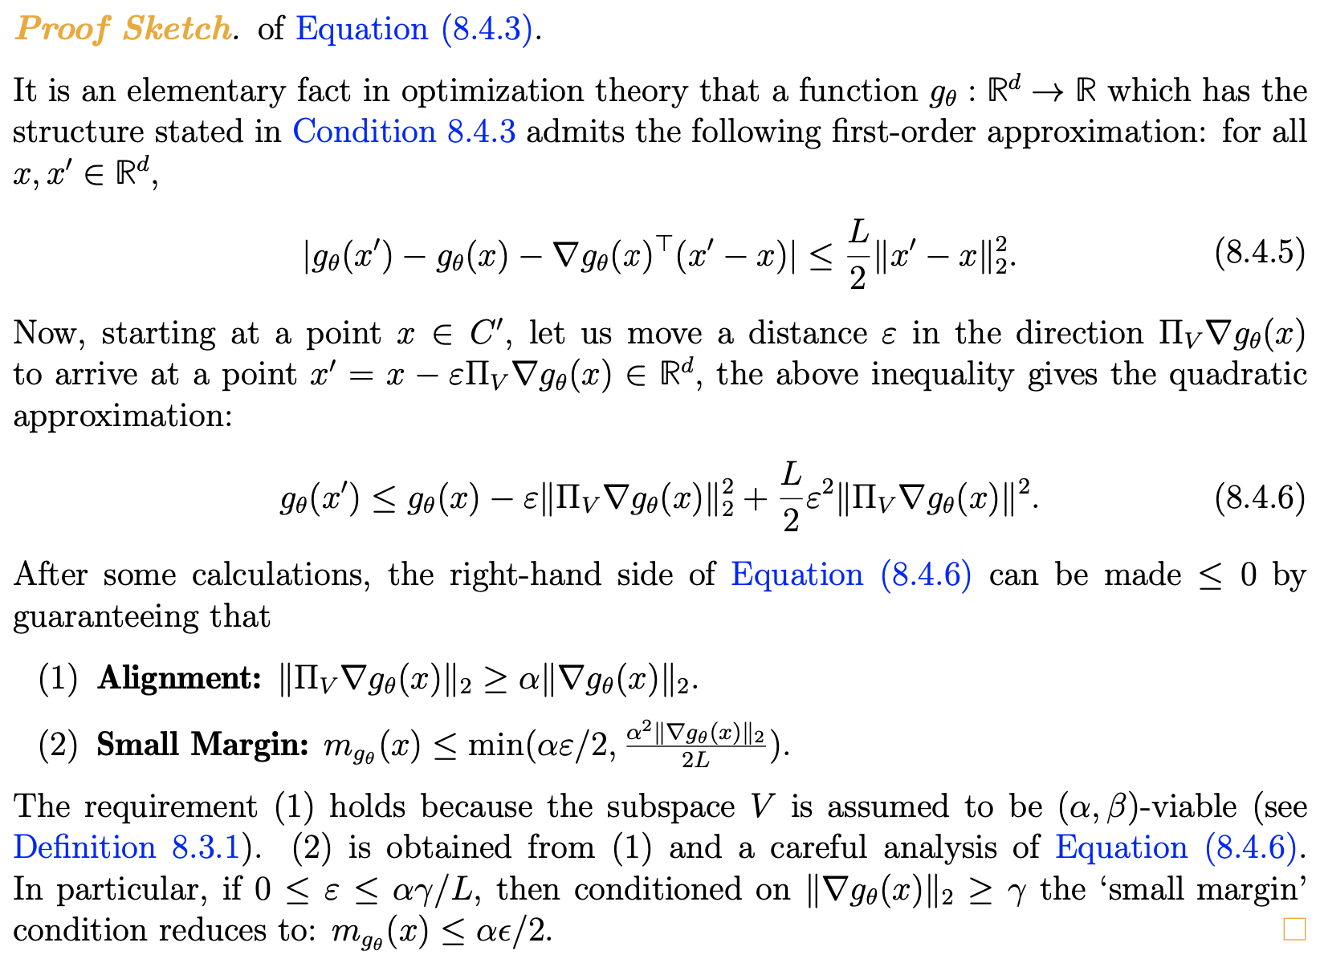
Low dimensional Attacks
Results on models with Lipschitz Decision Boundaries

Slide 56
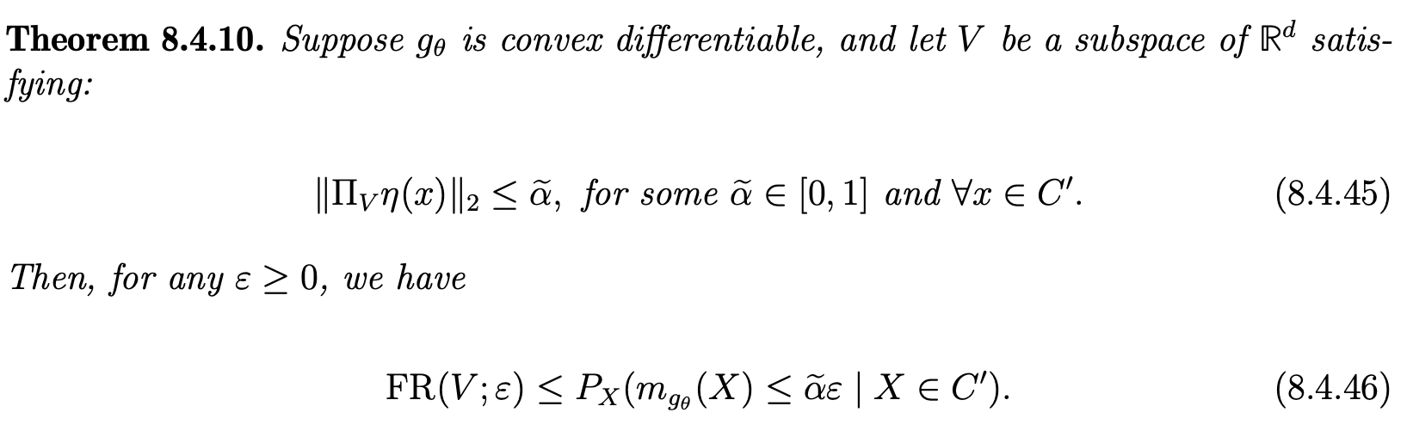
Low dimensional Attacks
Matching upper bound for convex decision regions

Slide 57

Low dimensional Attacks
Applications to Neural Networks
Types of neural networks for which the results hold:
Random Features regime: random weights except in the last layer + conditions on the layers
2) Lazy regime: the weights of the neural network stay close to their initialization values + additional conditions on the feature map, gradients, etc

Slide 58
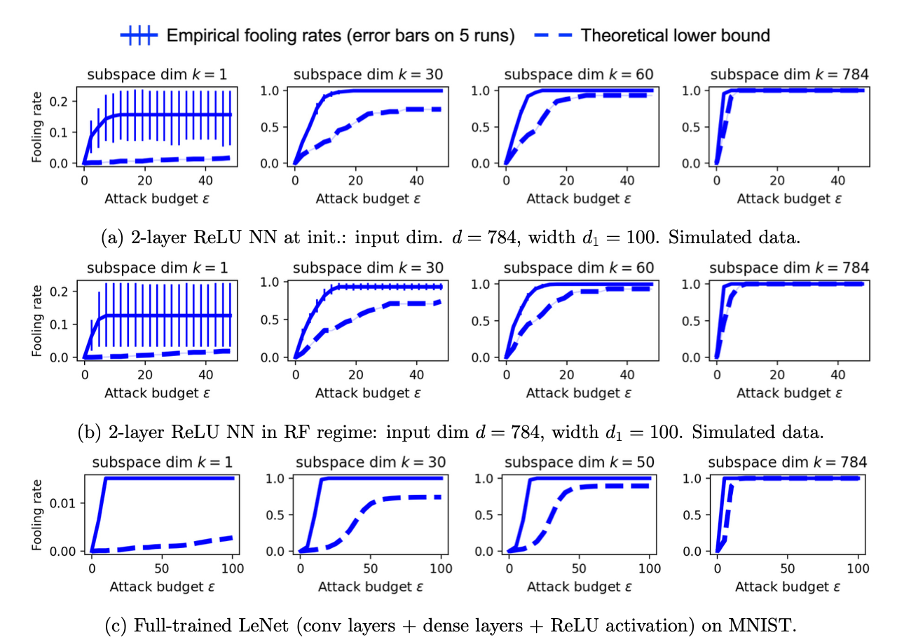
Low dimensional Attacks
Results – Random Subspace attack

